Slide 1




Slide 2
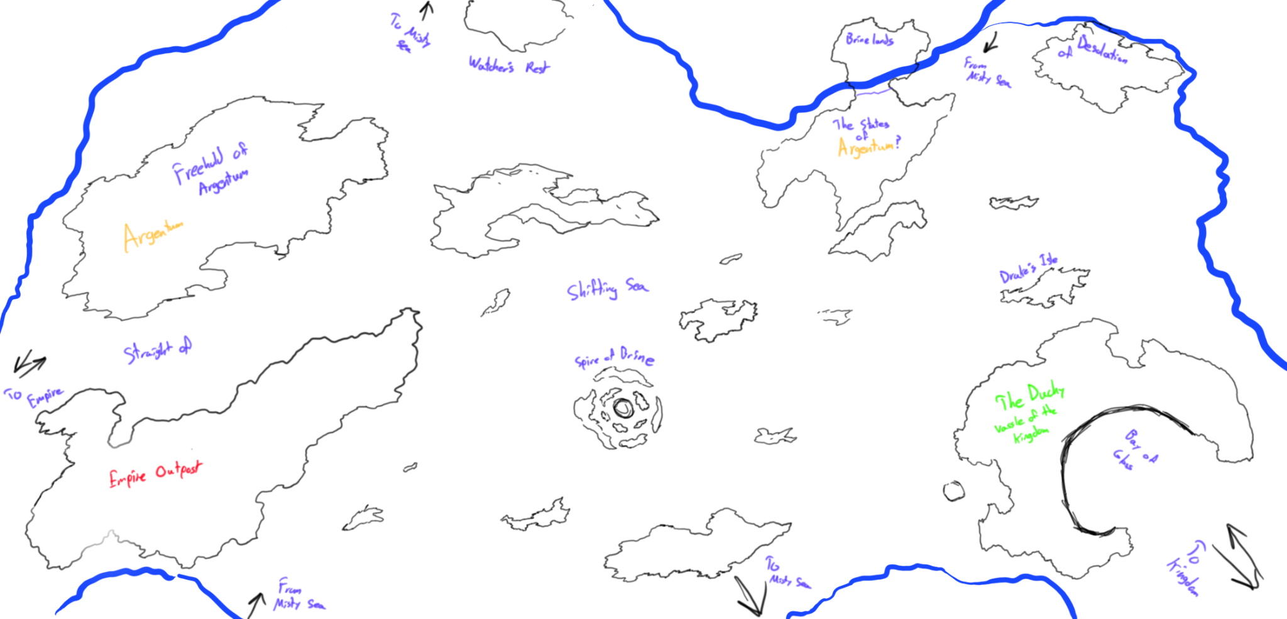

Initial Concepts:
Pirate ship navigation
Crew maintenance
Romanceable NPCs
Branching decision trees
3 Main Story Paths
World Building:
Map-making + “The Veil”
Inspirations:
Sea of Thieves
Baldur’s Gate 3
Dungeons and Dragons
A labeled world map drawn by Norman in the beginning stages of the project
Sample Tavern Music made by Russell to experiment with atmospheric elements

Slide 3
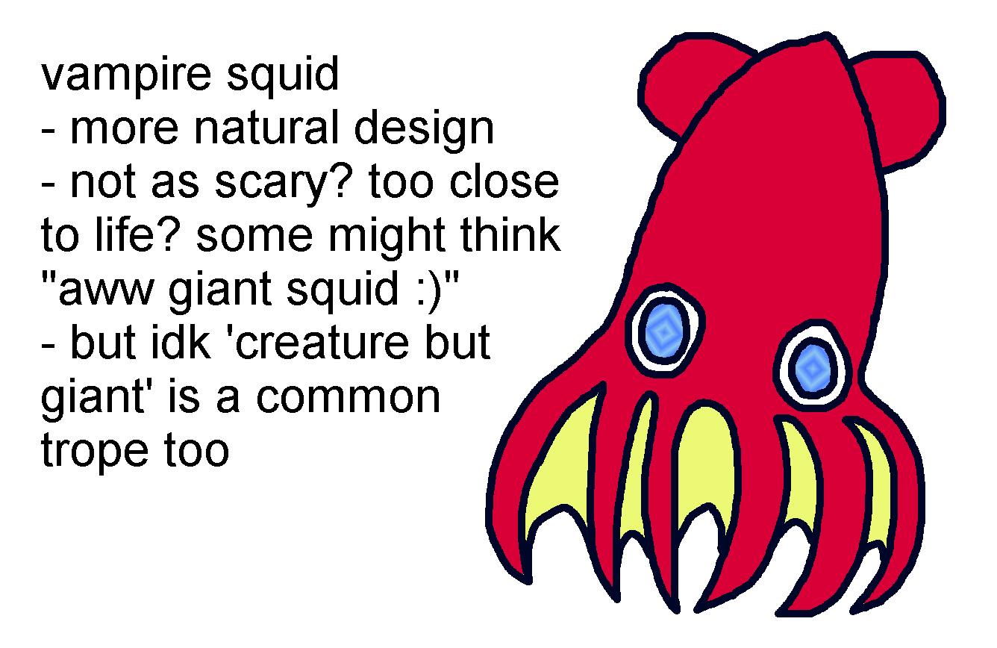
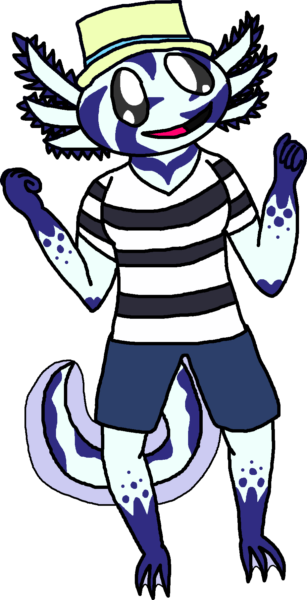
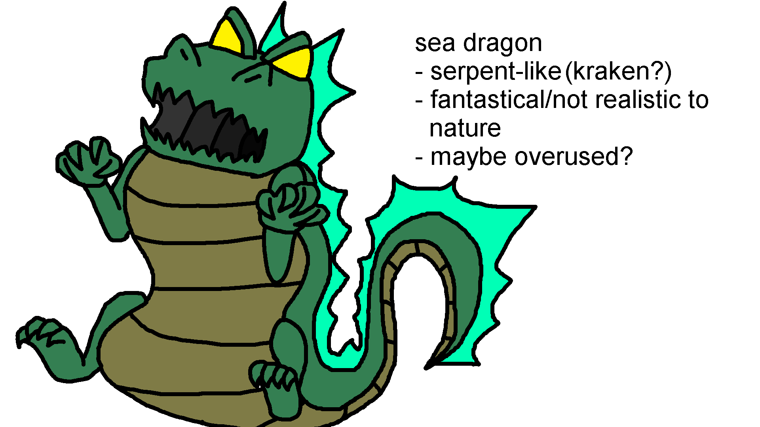
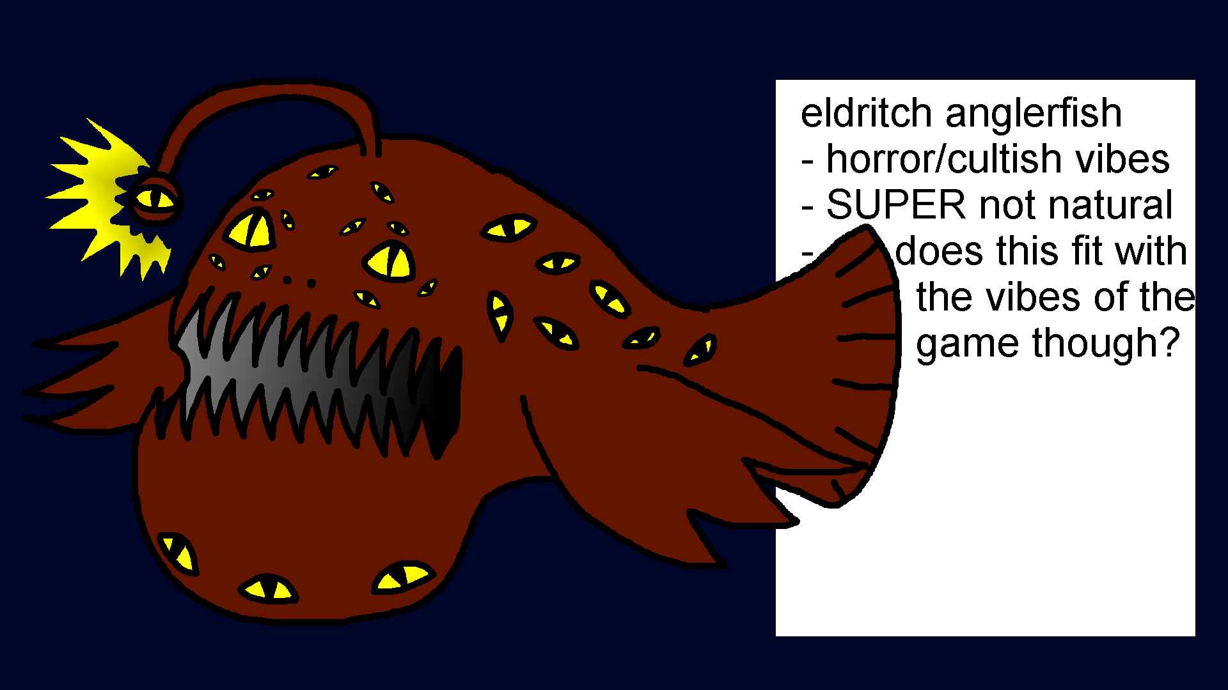
Fantasy V.S. Historical Fiction
Balance of realism/fantastical
Need for tangible stakes: when does fantasy verge into unrelatable?
How much can a player be expected to know about the historical basis?
Pre-Written Lore:
How much is too much information?
Player agency in being given information is key!
Balancing player choice and established canon
Concept art drawn by Derek of Lottie and 3 potential sea monster designs

Slide 4
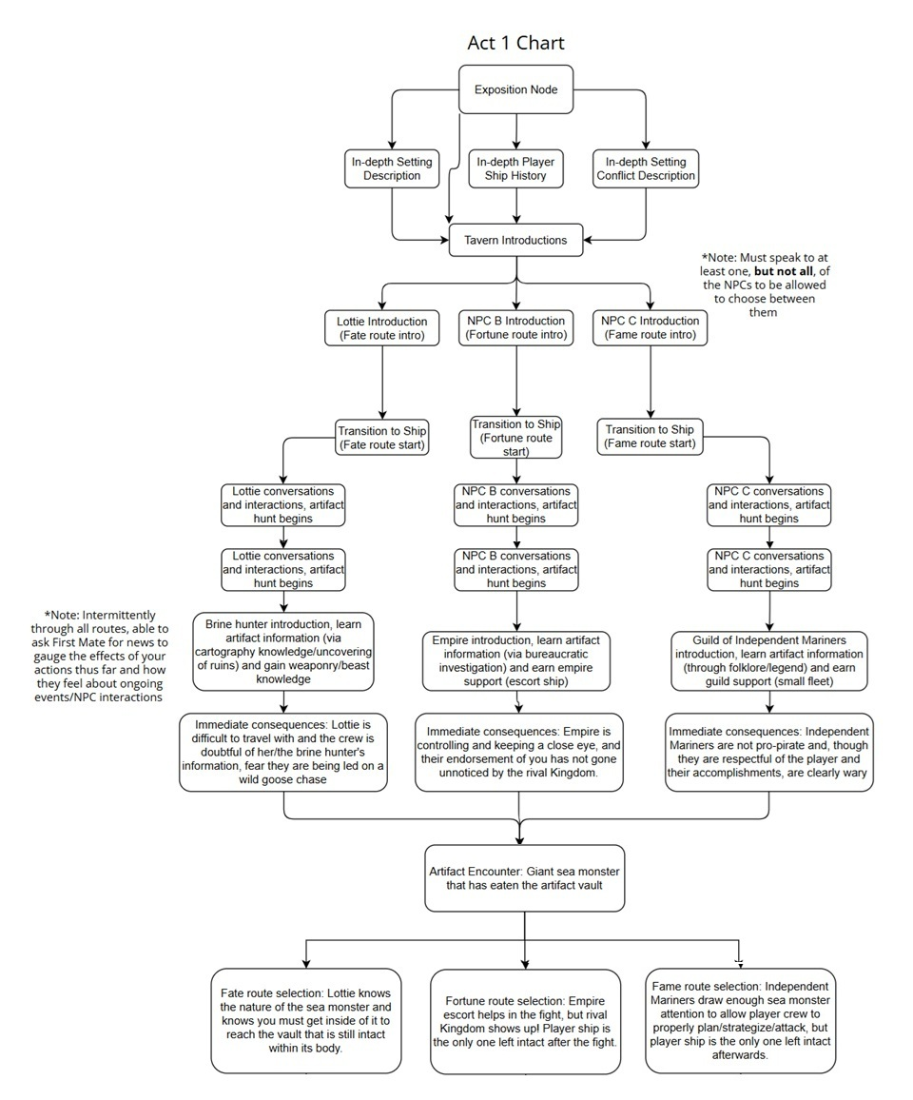
Act 1:
Introduction to NPCs, exposition, setting
“The Adoration”
First Mate Rosemary
Beginning the hunt for the artifact
Varying means based on NPC choice
Varying player/crew interactions based on NPC choice
Separate Decision Trees for each NPC with their own story beats and challenges
Sea monster encounter
Obtain artifact with NPC help

Slide 5
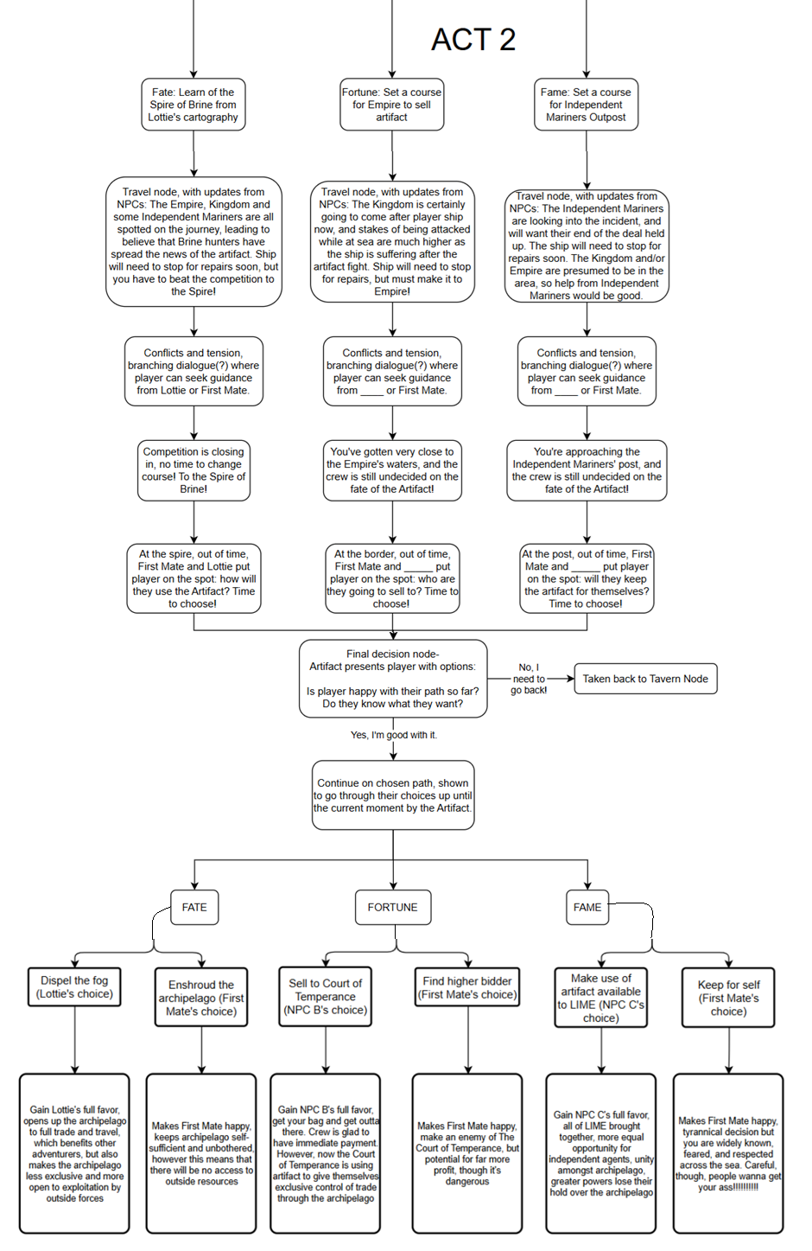
Act 2:
Immediate consequences of Player actions
Crew/Player/NPC conflict
Varying based on NPC choice
Player chooses who they confide in: chosen NPC or First Mate Rosemary
Glimpses of how the world will change depending on final Player choice
FINAL DECISION NODE:
Continue on your path OR go back to the tavern?
Original intent to make replay mandatory

Slide 6
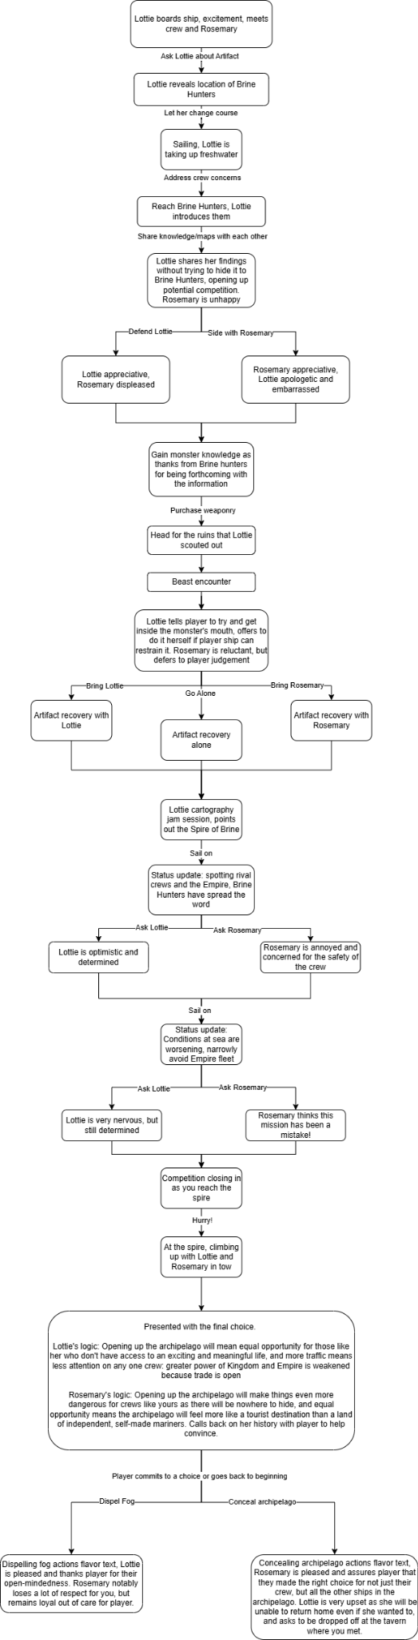
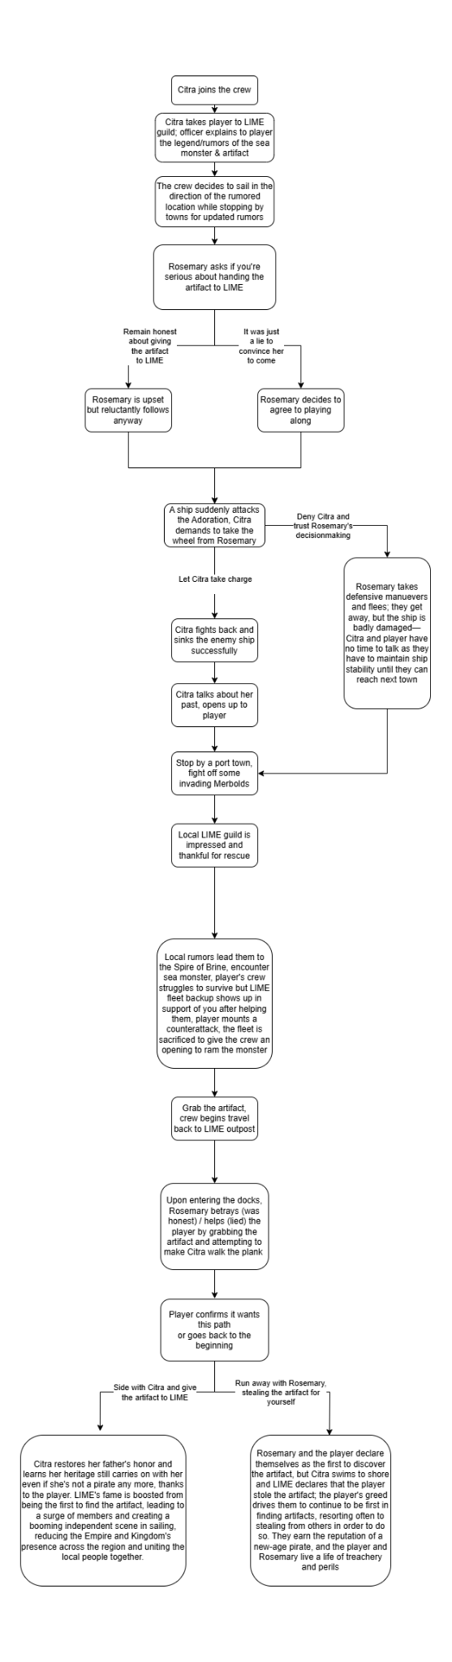
Individualized NPC Trees
Emphasis on player connection
Very dialogue/text heavy
Each NPC offers their own challenges/quirks that make your travels with them unique
NPC Characterization
Fate Route: Lottie - Created by Russell
Fortune Route: Samara - Created by Norman
Fame Route: Citra - Created by Derek
First Mate: Rosemary - Created by Nico
Lottie and Citra’s decision trees, respectively

Slide 7




Dispel The Fog (Lottie’s Choice):
Gain Lottie’s full favor, opens up the archipelago to full trade and travel, which benefits other adventurers but also makes the archipelago less exclusive and more open to exploitation by outside forces
Enshroud the Archipelago (First Mate’s Choice):
Makes Rosemary happy, keeps archipelago self-sufficient and unbothered, however this means that there will be no access to outside resources.
Sell to Court of Temperance (Samara’s Choice):
Gain Samara’s full favor, get your bag and get outta there! Crew is glad to have immediate payment. However, now the Court of Temperance is using artifact to give themselves exclusive trade control
Give artifact to LIME (Citra’s Choice):
Gain Citra’s full favor, all of LIME brought together, more equal opportunity for independent agents, unity amongst archipelago, greater powers lose their hold
Keep artifact (First Mate’s Choice):
Makes First Mate happy, tyrannical decision but you are now widely known, feared and respected across the sea. The Adoration will not know peace again!
Find Higher Bidder (First Mate’s Choice):
Makes First Mate happy, make an enemy of The Court of Temperance, but potential for far more profit, though it’s very dangerous

